Slide 1
Module 1 What is Competitive Strategy Lesson 3 Analysis of Industry Forces

Slide 2
M. Krishna Erramilli

Slide 3
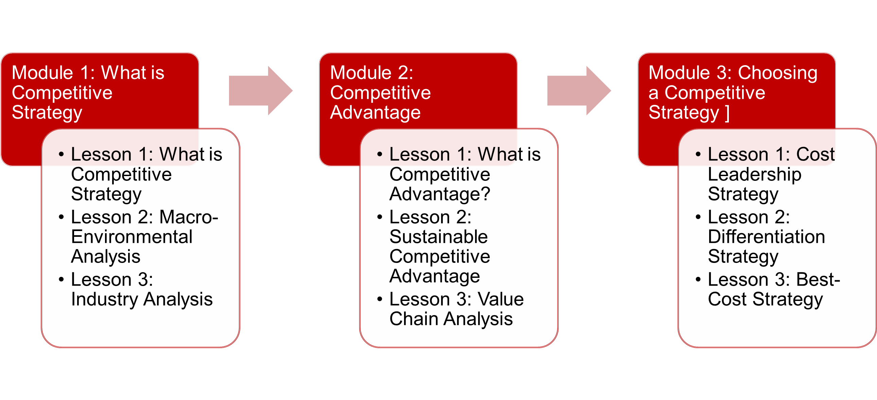
This Lesson

Slide 4
What is an industry?
Industry is a group of firms producing products or services that meet the same customer needs.
Examples of some industries
Smartphone (e.g., Apple, Samsung)
Soft drinks (e.g., Coca Cola, Pepsi)
US Domestic Airlines (e.g., United, Delta, American, Southwest)

Slide 5
Why study industries?
Statistical analysis suggests that 10% to 20% of the variation in a company’s profitability is explained by membership in its industry.
Industry analysis helps explain why some industries are more profitable than others

Slide 6
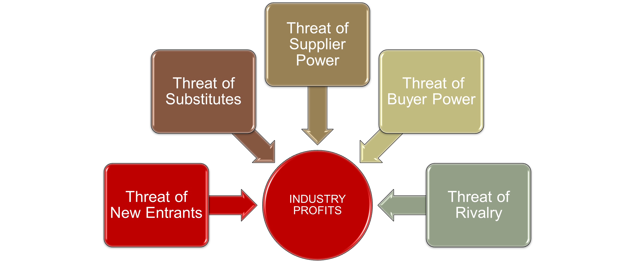
Five Forces That Affect Industry Profits

Slide 7
What are the forces affecting the profitability of the US Domestic Airlines industry?

Slide 8
Five Forces in US Domestic Airlines Industry
Threat of New Entrants (Any Company Attempting To Enter The Industry By Launching A New Airline)
Threat of Substitutes (e.g., Private Cars, Buses, Trains, Ships)
Threat of Supplier Power (e.g., Aircraft Manufacturers Like Boeing And Airbus, Aviation Fuel Suppliers)
Threat of Buyer Power (e.g., Passengers, Travel Agencies)
Threat of Rivalry (e.g., competitors like American, United, Delta, Southwest)

Slide 9
Threat of New Entrants
Lower the barriers to entry, higher the threat
How high are the barriers to entry in the US domestic airline industry?
Some barriers to entering an industry
Economies of scale
Capital requirements
Differentiation
Switching costs
Government regulations
Threat of new entrants in US domestic airline industry is moderate.

Slide 10
Threat of Substitutes
How attractive are substitute products/services (cars, buses, trains, ships, videoconferencing) in the US domestic airline industry?
Overall threat of substitutes in the US domestic airline travel industry is moderate.

Slide 11
Threat of Buyer Power
Powerful Buyers threaten profits of an industry
Force down prices
Bargain for higher quality or more services
Play competitors against each other
How powerful are buyers (individual passengers, travel agencies, institutional buyers) in the US domestic airline industry?
3. Overall, buyer power in the US domestic airline travel industry is moderate.

Slide 12
Threat of Supplier Power
Suppliers can exert power by threatening to raise prices or reduce the quality of purchased goods and services
How powerful are the suppliers (e.g., Boeing, Airbus, oil companies) to the US domestic airline industry?
Overall, supplier power in the US domestic airline travel industry is strong.

Slide 13
Threat of Rivalry
Suppliers can exert power by threatening to raise prices or reduce the quality of purchased goods and services
How intense is the rivalry (e.g., American, United, Delta, Southwest) to the US domestic airline industry?
Interacting factors lead to intense rivalry
Numerous or equally balanced competitors
Slow industry growth
High fixed costs
Lack of differentiation or switching costs
Overall, the threat of rivalry in the US domestic airline travel industry is strong.

Slide 14
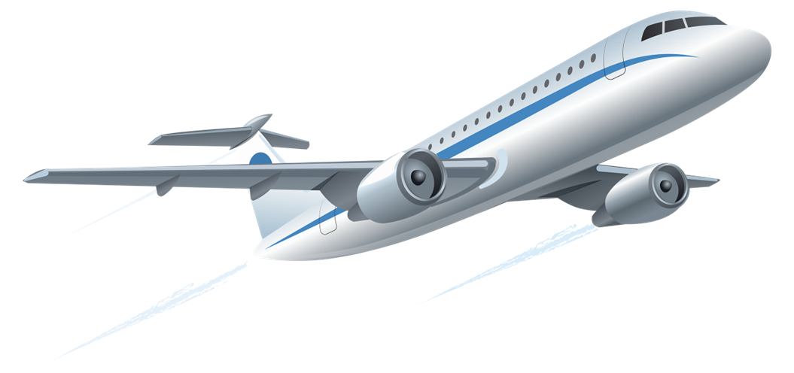
Analysis of US Domestic Airlines Industry
Industry Force | Threat Level
Threat of New Entrants | Moderate
Threat of Substitutes | Moderate
Bargaining Power of Suppliers | Strong
Bargaining Power of Buyers | Moderate
Threat of Competitive Rivalry | Strong

Slide 15
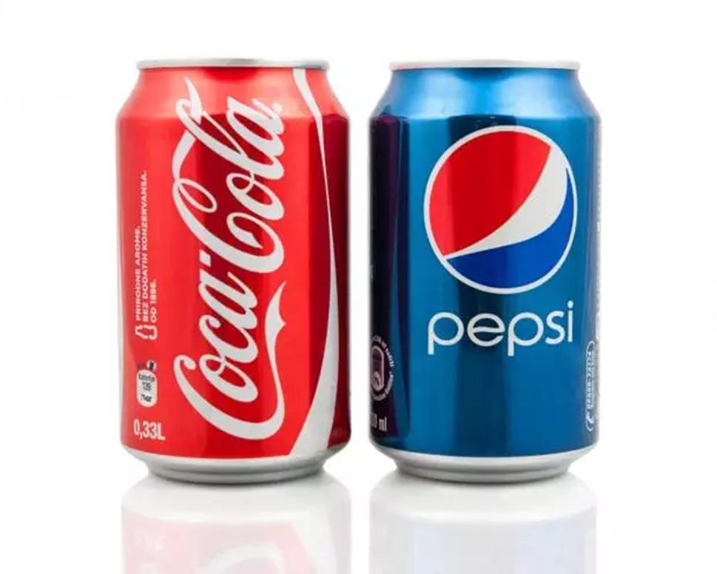
US Carbonated Soft Drinks Industry
Industry Force | Soft Drinks
Threat of New Entrants | Weak
Threat of Substitutes | Moderate
Bargaining Power of Suppliers | Weak
Bargaining Power of Buyers | Moderate
Threat of Competitive Rivalry | Moderate

Slide 16
Comparison of US Airline and Soft Drinks Industries
Industry Force | Soft Drinks | Airlines
Threat of New Entrants | Weak | Moderate
Threat of Substitutes | Moderate | Moderate
Bargaining Power of Suppliers | Weak | Strong
Bargaining Power of Buyers | Weak to Moderate | Moderate
Threat of Competitive Rivalry | Moderate | Strong

Slide 17
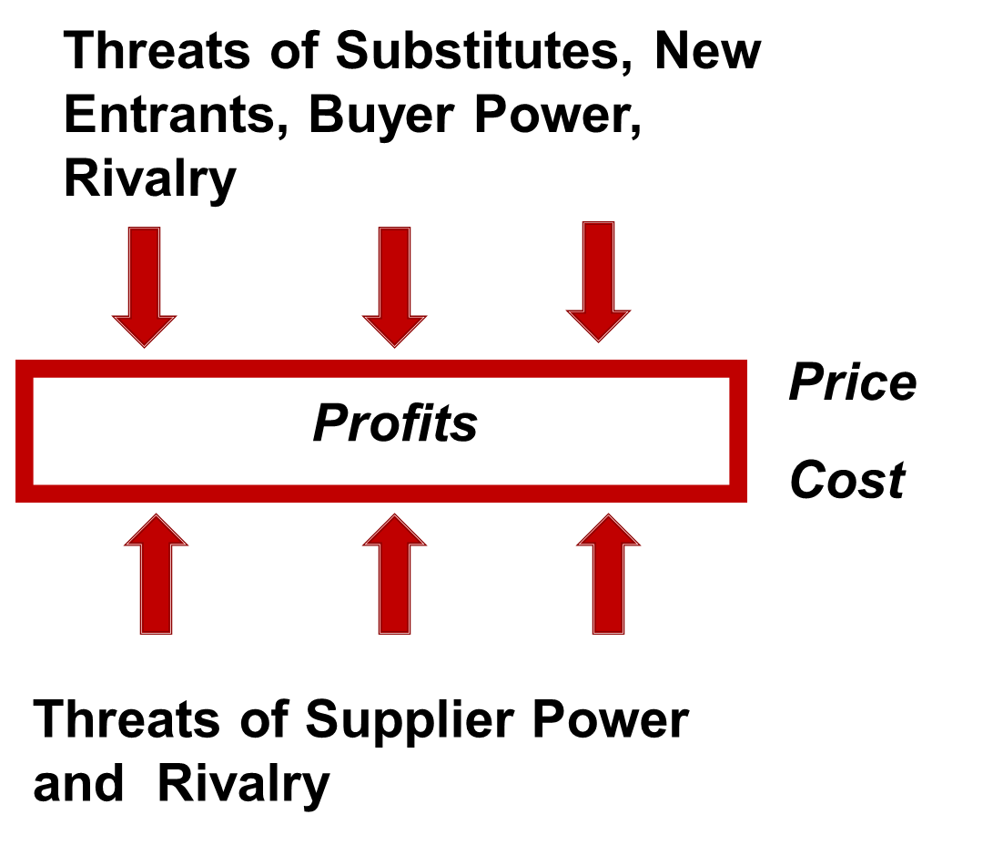
So, what do we conclude from the analysis?
Overall, the US domestic airline industry is not as profitable as the soft drinks industry

Slide 18

This Lesson

